Slide 1
Error Machine

Slide 2
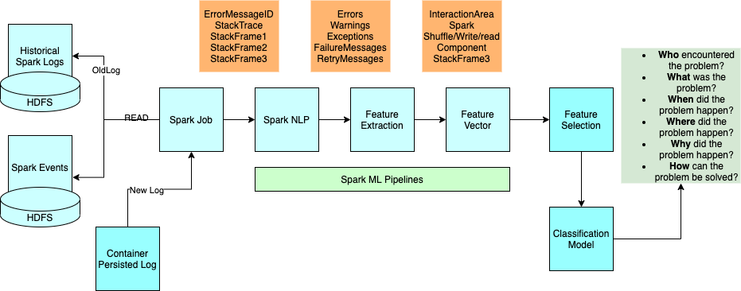
Overall Architecture

Slide 3
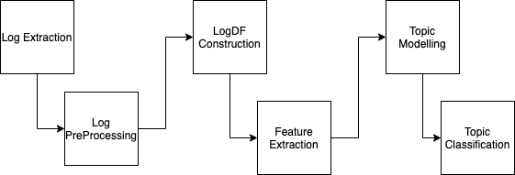
Process

Slide 4
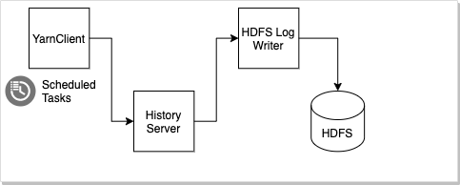
Log Extraction

Slide 5
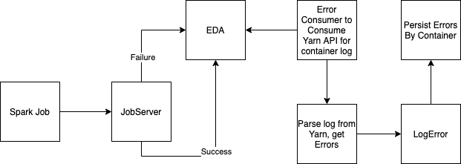
Log Notify Extraction

Slide 6

Log PreProcessing

Slide 7
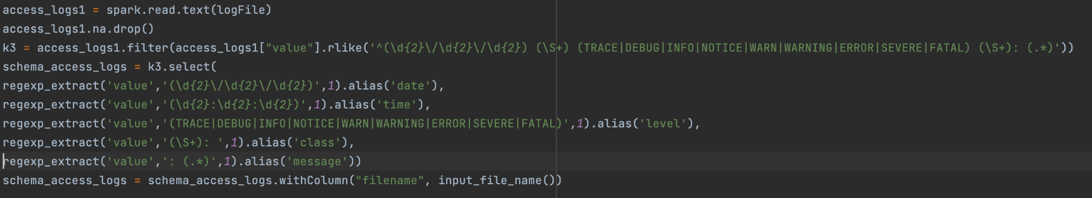
Log PreProcessing

Slide 8
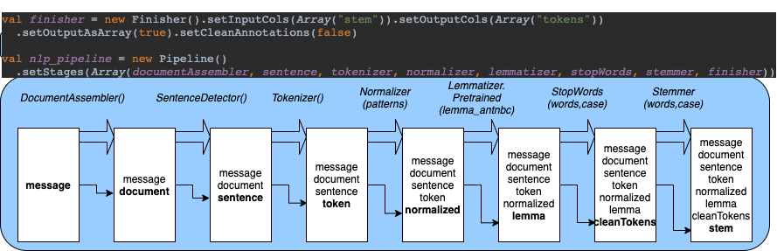
NLP - PreProcessing

Slide 9
Pipeline
val finisher = new Finisher().setInputCols(Array("stem")).setOutputCols(Array("tokens"))
.setOutputAsArray(true).setCleanAnnotations(false)
val nlp_pipeline = new Pipeline()
.setStages(Array(documentAssembler, sentence, tokenizer, normalizer, lemmatizer, stopWords, stemmer, finisher))

Slide 10
Yake
Yake is an :
Unsupervised, Corpus-Independent, Domain and Language-Independent and Single-Document keyword extraction algorithm.

Slide 11
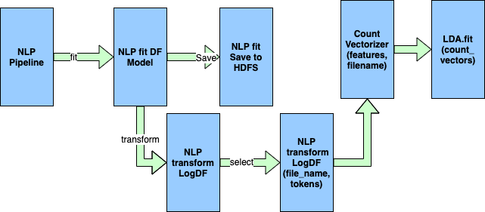
NLP- LDA

Slide 12
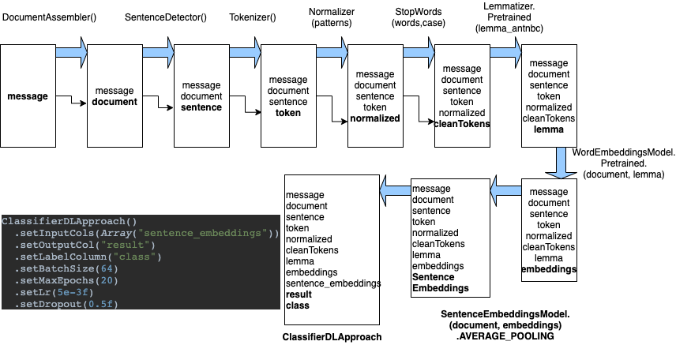
Pipelines- Classification with word and Sentence Embeddings

Slide 13
Word Embeddings
GloVe (Global Vectors for Words Representations)
ELMo (Embeddings from Language Models)
BERT (Bidirectional Encoder Representations from Transformers)

Slide 14
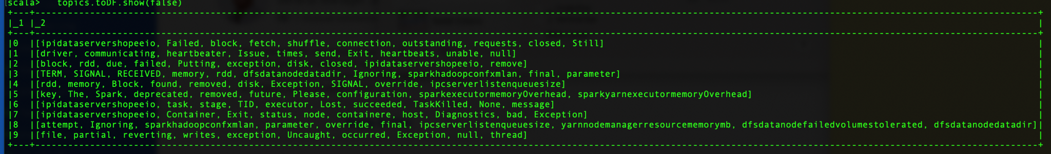
Topics List 1 - Bad

Slide 15
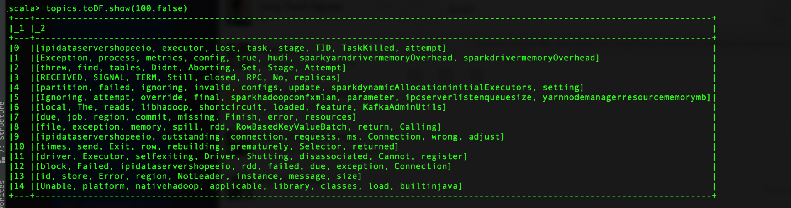
Topic List 2 - Need cleaning

Slide 16
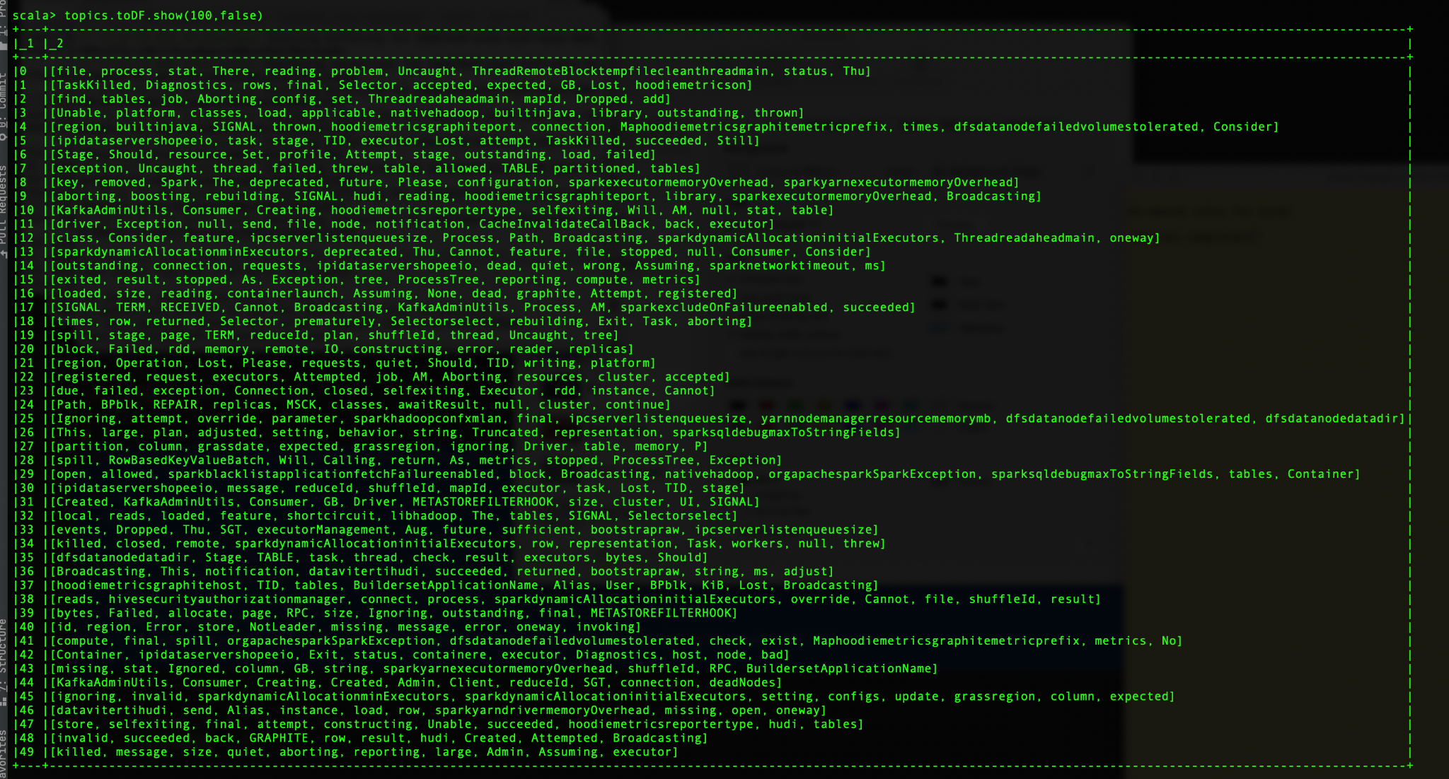
Topics List 3 - Too Many Topics

Slide 17
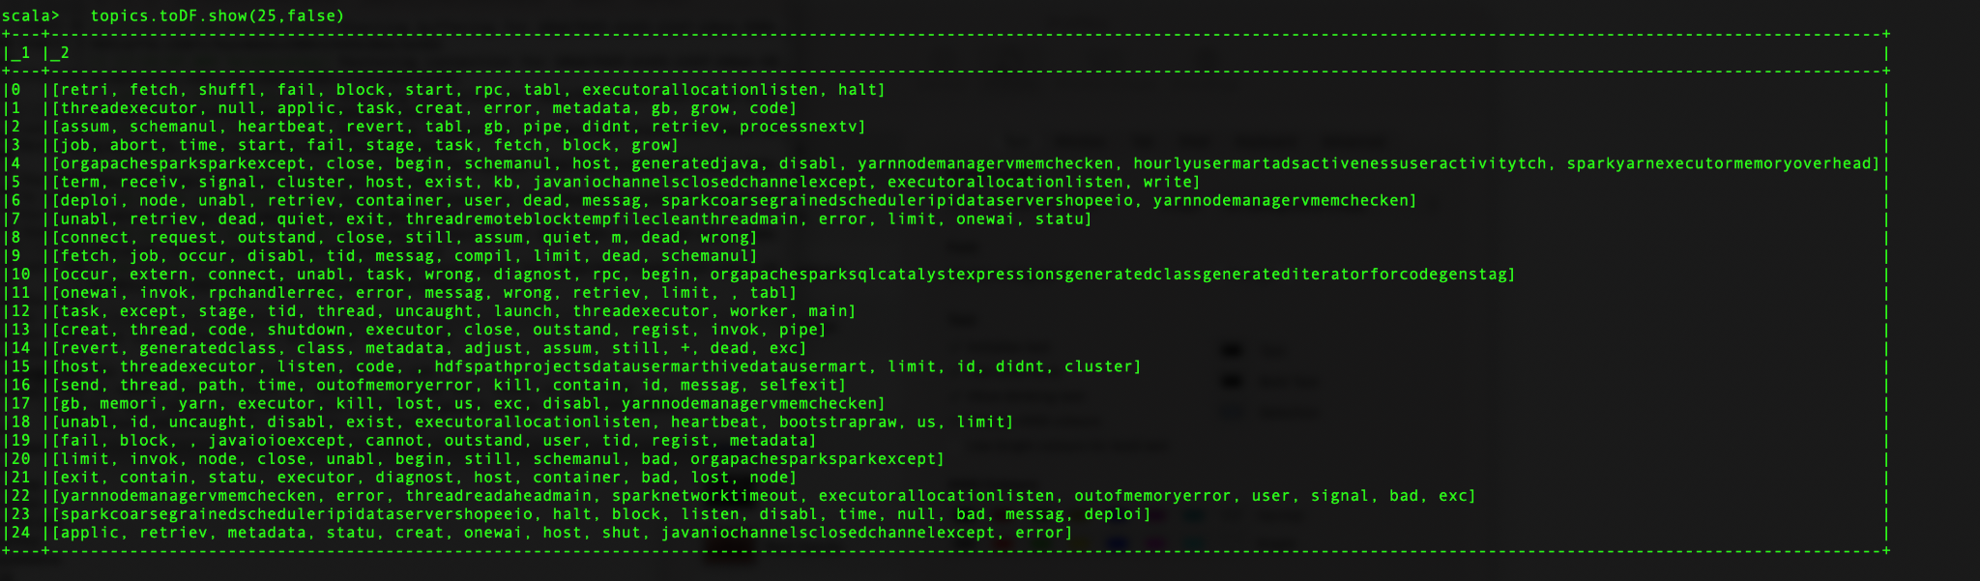
Key word Based - Specifics ( better granularity )

Slide 18
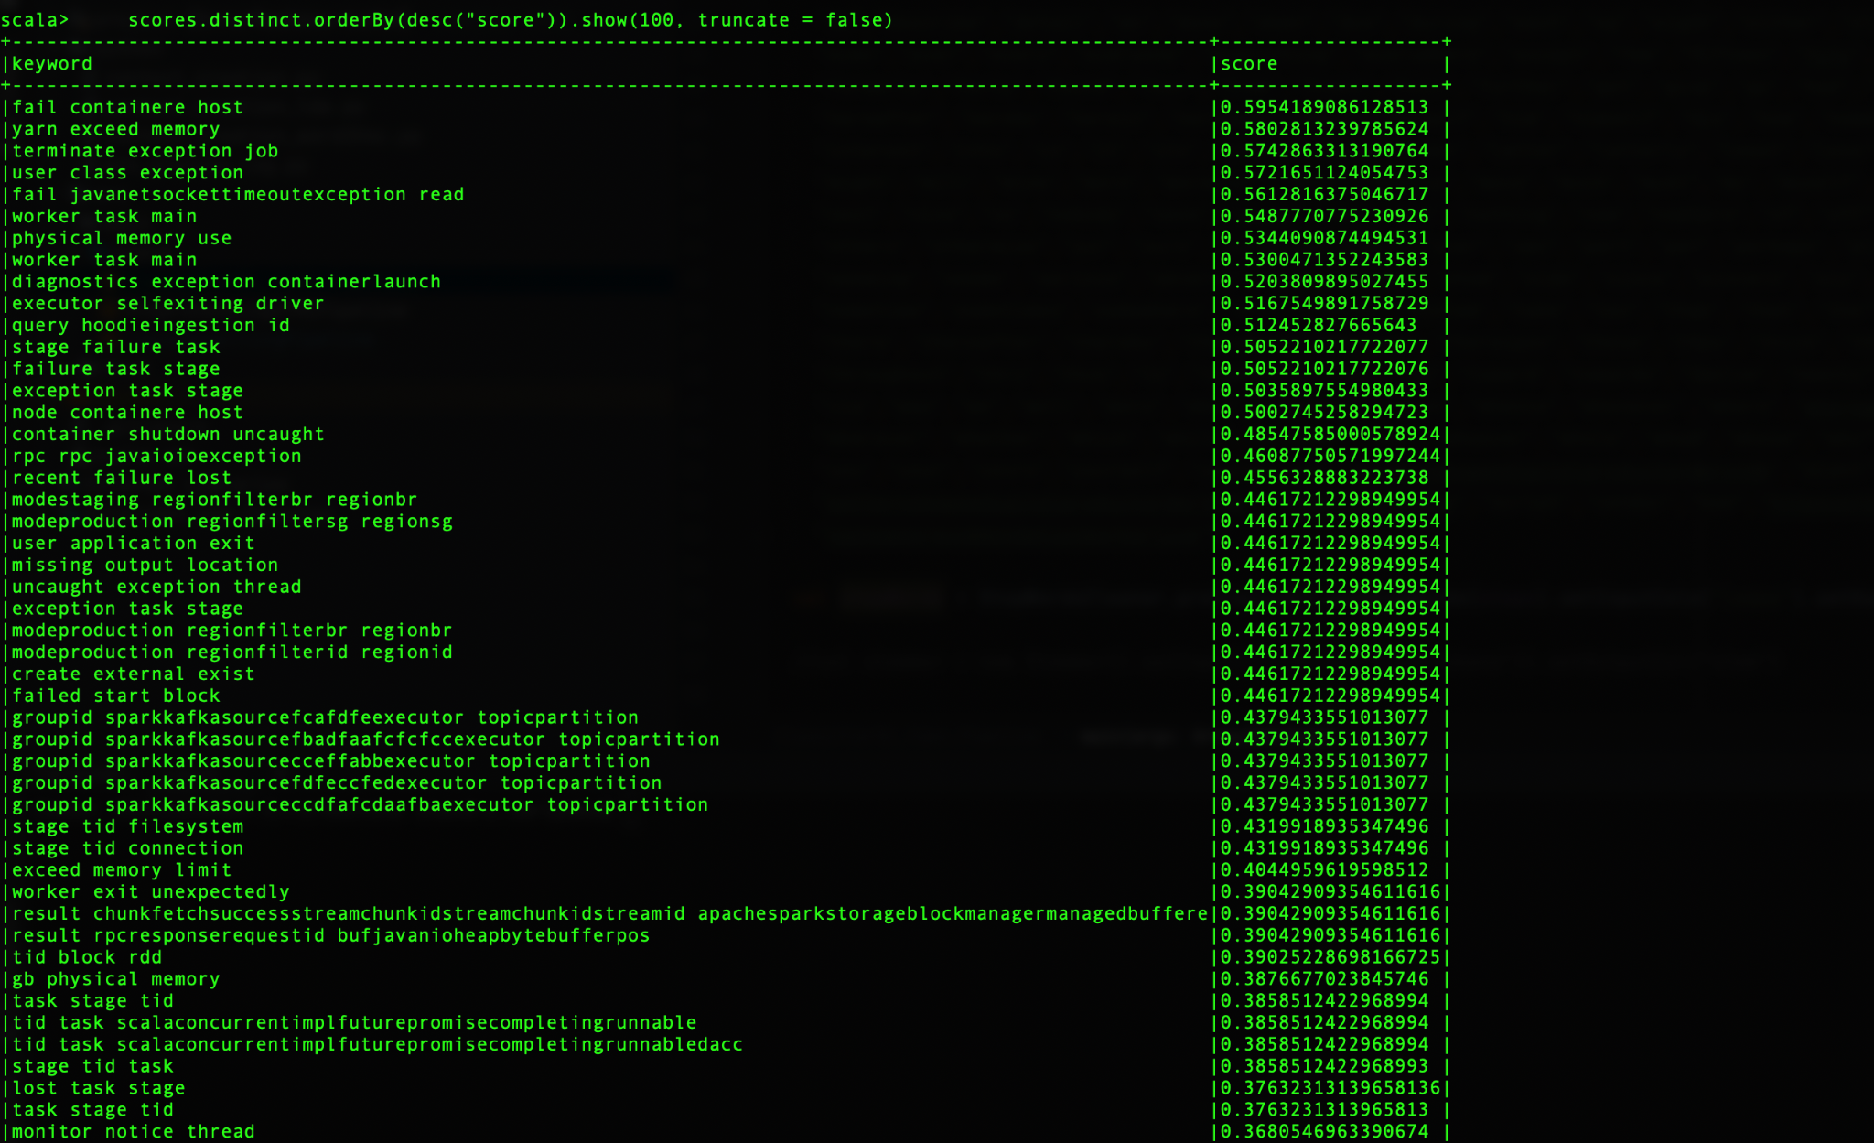
Classification score & Match

Slide 19
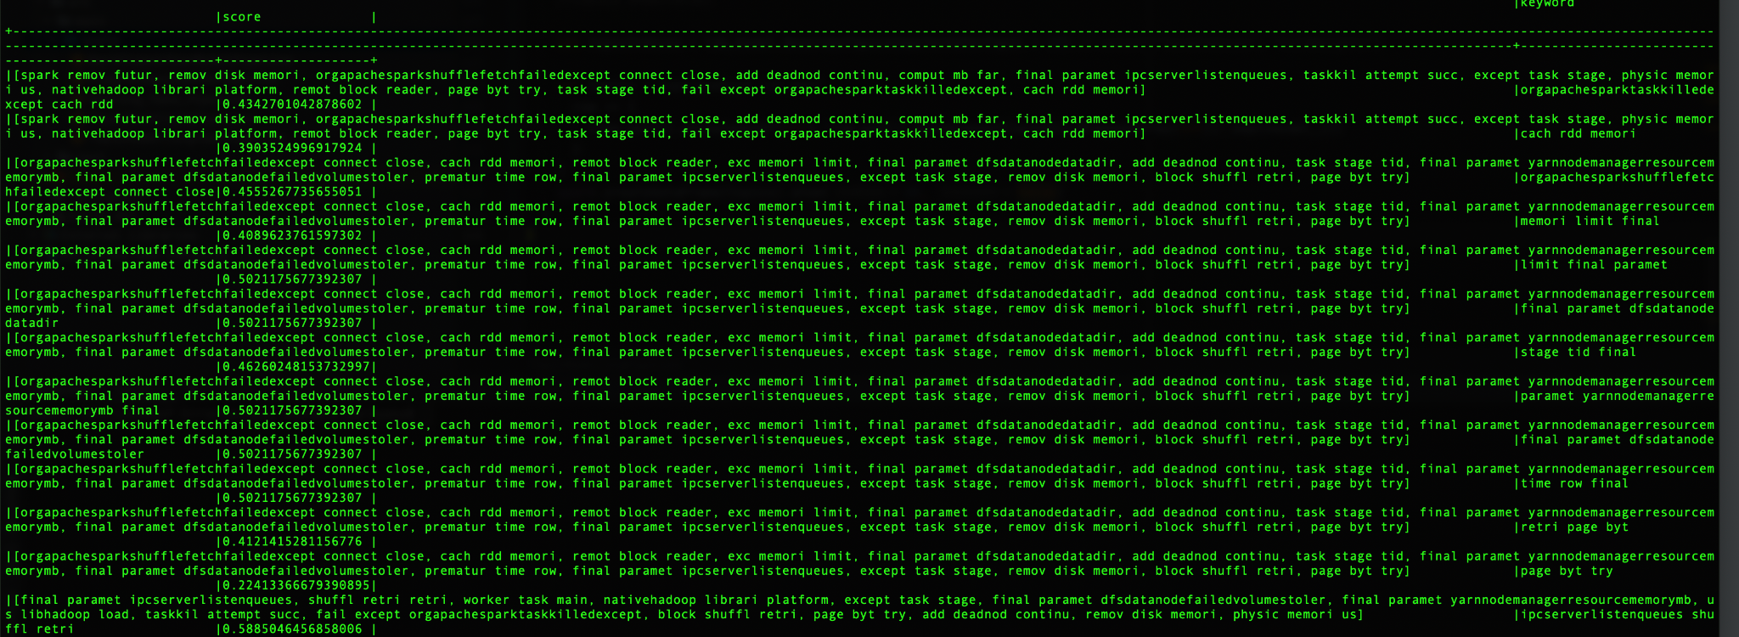

Slide 20
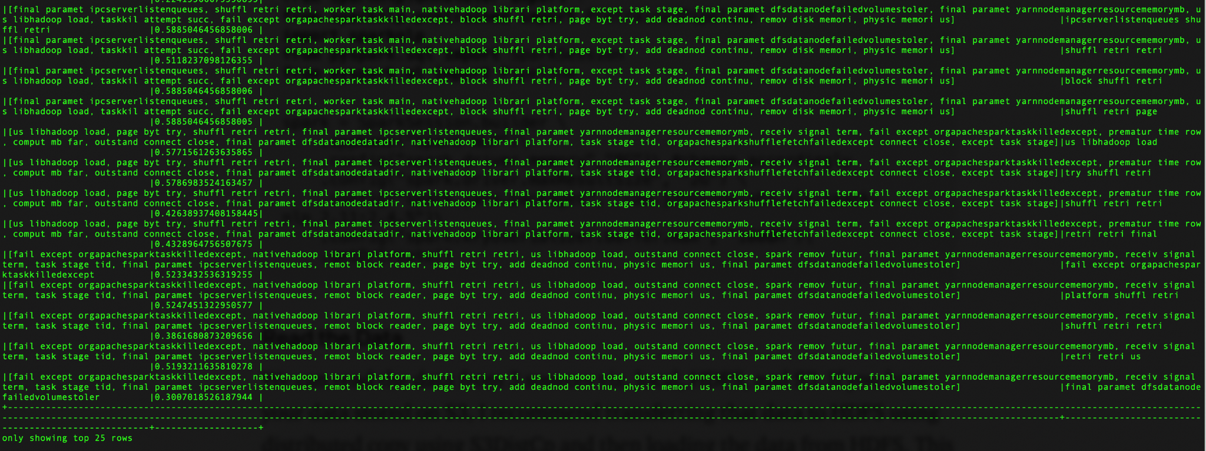

Slide 21
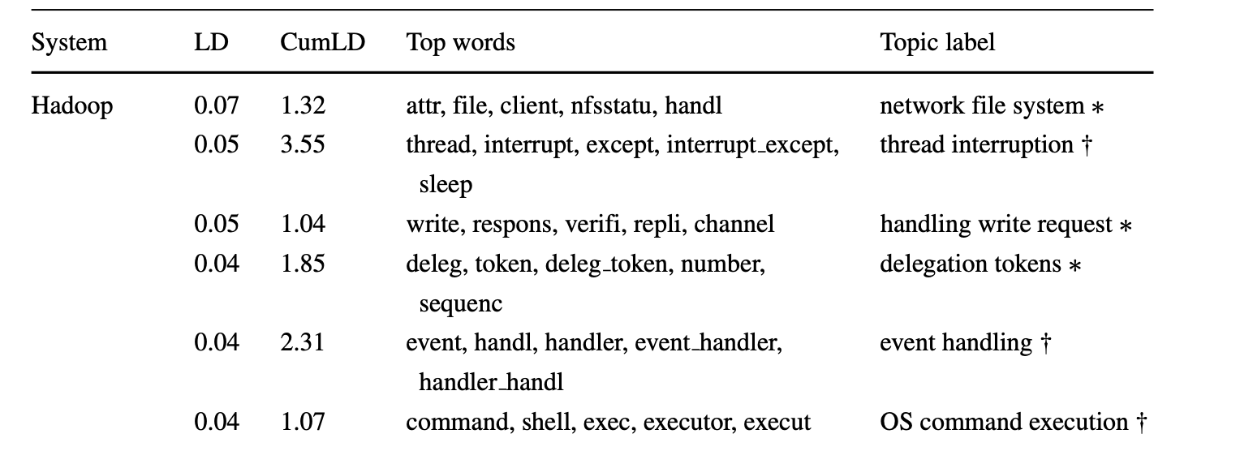
Topic Model over Hadoop log messages

